Slide 1
SMART MANUFACTURING
PROJECT
Course Instructor: Dr. Raja vara Prasad Y
GROUP - 05

Slide 2
Group Members:
K. LITHEESH KUMAR - S20190020218 (UG-3, ECE)
P. GOVARDHAN NAIK - S20190010135 (UG-3, CSE)
SRIKANTH YADAV - S20190010026 (UG-3, CSE)
K ROKESH REDDY - S20190010098 (UG-3, CSE)
K. BHANU CHAITANYA - S20190010097 (UG-3, CSE)

Slide 3
Project Ideas:
Weather Monitoring and Prediction using Machine Learning and IOT
Soil Quality Monitoring and Crop Prediction using IOT and ML
Smart Health Monitoring using IOT and ML

Slide 4
First Idea
WEATHER MONITORING AND PREDICTION USING
MACHINE LEARNING AND IOT
Continuously monitor the weather i.e temperature, humidity, barometric pressure, rainfall which will be collected using sensors. alert the user through mobile app with respect to the weather conditions. the huge data collected through sensors will be trained using ML models and build a weather prediction model with the collected data and deploy it using flask.
Base idea
Motivation
To determine the live weather monitoring and the weather forehead and be prepared for any drastic changes etc

Slide 5
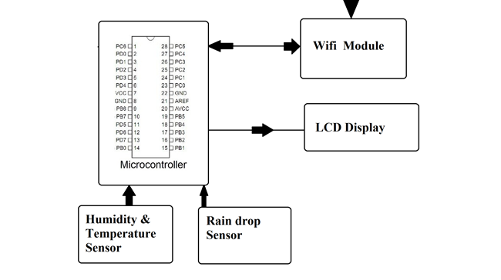
Proposed System Design
Website
APP
Notification

Slide 6
SOIL QUALITY MONITORING AND CROP PREDICTION USING IOT
Second Idea
This project aim is to identify chemical properties of soil and suggest which crop should be taken in that soil. Where are chemical properties like PH values, humidity, temperature, soil moisture, etc. The systematic implementation will introduced semi-supervised learning implementation using Q-learning algorithm
Base idea
To suggest the farmer forehead about the profitable crop and make them well prepared for the unexpected conditions.
Motivation

Slide 7
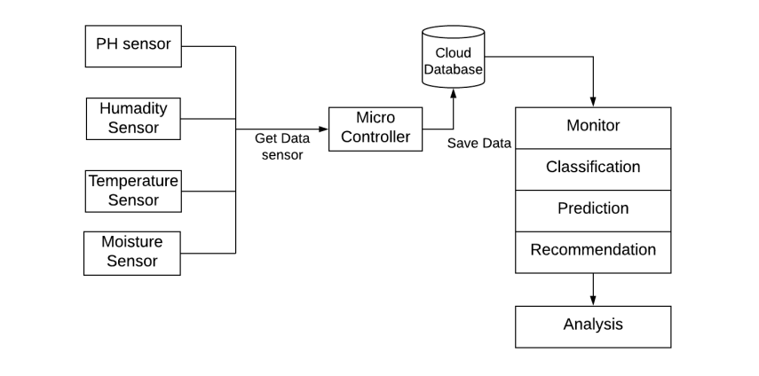
Proposed System Design

Slide 8
Third Idea
SMART HEALTH MONITORING USING IOT
Continuously monitor the health i.e blood pressure, heart rate, ECG & temperature which will be collected using sensors. alert the user through mobile app with respect to the collected health data
using ML models we build a health alert system which alert the user about the health problems with the trained data set and deploy it using flask
Base idea
It is difficult for hospitals to frequently check patient’s conditions. Also continuous monitoring of ICU patients is very difficult. Cure the diseases at the early stage.So, our system is beneficial.
Motivation

Slide 9
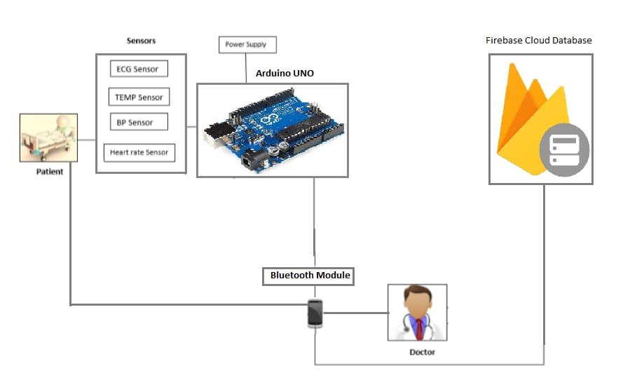
Proposed System Design

Slide 10
THANK YOU

